Slide 1
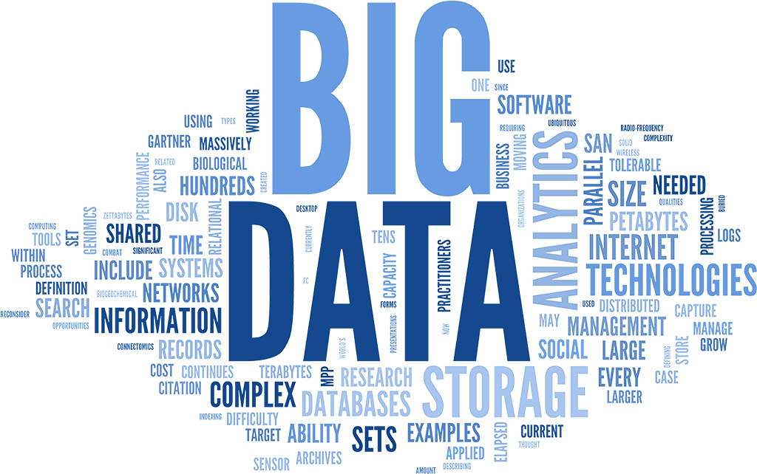
307401 Big Data and Data Warehouses
Introduction to Big Data

Slide 2
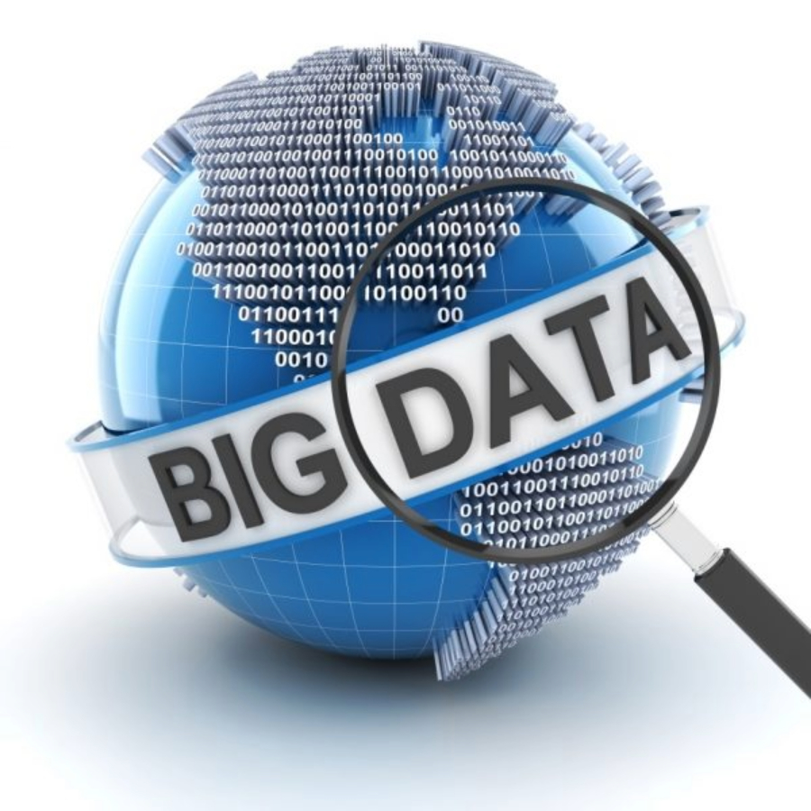
What is Big Data?
Big Data refers to datasets that are so large, diverse, and fast-changing that they exceed the capabilities of traditional data processing technologies and methods.
These datasets require advanced tools and techniques to capture, store, manage, and analyze effectively.

Slide 3
Motivations for Big Data
Global Connectivity:
Internet penetration, Mobile device usage
Technological Advancements:
Increased computing power, Improved storage solutions
Data Generation Sources:
Proliferation of IoT devices, Social media explosion
Economic and Business Needs:
Enhanced decision-making, Personalized marketing
Scientific and Research Advancements:
Genome sequencing, Astronomical data
Regulatory and Compliance Requirements:
Data retention policies, Transparency and accountability
User Expectations:
On-demand services, Enhanced user experience

Slide 4
Historical Evolution
Pre-1970s: Mainframe computers, batch processing, expensive storage, and limited analysis.
1970s: Introduction of RDBMS and SQL, revolutionizing structured data management.
1980s: Birth of data warehousing, concept of ETL, integration of data from multiple sources.
1990s: Growth of OLAP, data warehouse appliances, enhanced data analysis capabilities.
2000s: Emergence of Big Data, limitations of traditional systems, introduction of Hadoop and NoSQL databases.
2010s: Development of Spark, real-time data processing technologies, cloud computing.
2020s: Integration of AI and ML, rise of data lakes, edge computing, advanced analytics.

Slide 5
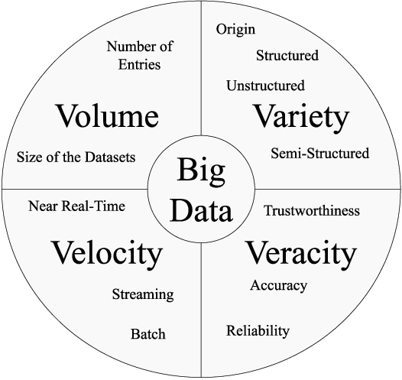
Challenges in Processing Big Data - The 5 Vs of Big Data
Volume: The sheer size of data generated every second.
Velocity: The speed at which new data is generated and processed.
Variety: The different types of data.
Veracity: The accuracy and trustworthiness of the data.
Value: The potential insights and benefits that can be derived from data.

Slide 6
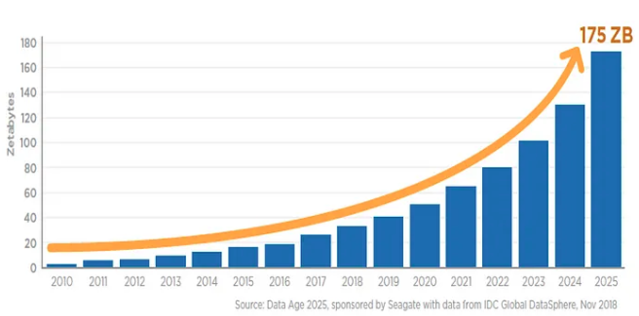
Volume
Volume refers to the amount of data generated and stored. This data is often measured in petabytes or exabytes.
Large data volumes requires scalable storage solutions and distributed processing power to manage and analyze.
Every day, 2.5 quintillion bytes of data are created (IBM).
Examples:
Social Media: Facebook generates 4 petabytes of data per day from user interactions.
E-commerce: Amazon handles millions of back-end operations daily, along with queries from more than half a billion customer accounts.
IoT Devices: Connected devices are expected to generate 79.4 zettabytes of data by 2025.

Slide 7
Velocity
Velocity refers to the speed at which data is generated, collected, and processed.
Velocity requires real-time data processing and analytics capabilities.
"90% of the world’s data has been generated in the last two years" (SINTEF).
Examples:
Financial Markets: Stock exchanges generate millions of transactions per second that need to be processed in real-time for trading decisions.
Online Advertising: Real-time bidding platforms process terabytes of data within milliseconds to serve targeted ads.
Sensors and IoT: Autonomous vehicles generate and process data in real-time to make driving decisions.

Slide 8
Variety
Variety refers to the different types of data: structured, semi-structured, and unstructured.
Variety requires advanced data integration techniques and diverse analytical tools.
Examples:
Structured Data: Traditional databases with tables and columns, such as customer information in a CRM system.
Semi-Structured Data: JSON, XML files, log files from servers.
Unstructured Data: Text from social media posts, images, videos, emails, and audio files. For example, 95 million photos and videos are shared on Instagram daily.

Slide 9
Veracity
Veracity refers to the accuracy, reliability, and trustworthiness of data.
Veracity requires robust data cleaning, validation, and governance to ensure data accuracy and reliability.
Challenges: Inconsistencies, biases, noise.
Examples:
Social Media Data: User-generated content can contain noise, biases, and inaccuracies that need to be filtered.
Product ratings on an online marketplace might be skewed by fake reviews posted by automated bots or competitors.
A temperature sensor in a smart home system might report incorrect values due to dust accumulation or hardware faults.
Web server logs might contain duplicated or corrupted entries due to server crashes or improper shutdowns, leading to inaccurate traffic analysis.

Slide 10
Value
Value refers to the insights and benefits derived from analyzing Big Data.
The ultimate goal of Big Data is to extract meaningful insights that drive better decision-making and innovation.
Examples:
Retail: Walmart uses Big Data analytics to optimize its supply chain, reducing costs and improving efficiency.
Healthcare: Predictive analytics helps in early diagnosis of diseases, personalized treatment plans, and improved patient outcomes.
Marketing: Companies like Netflix use data analytics to recommend personalized content, enhancing customer experience and increasing retention.

Slide 11
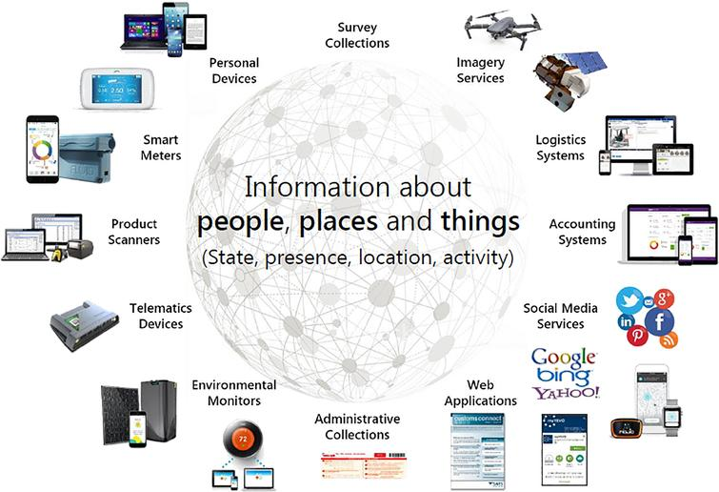
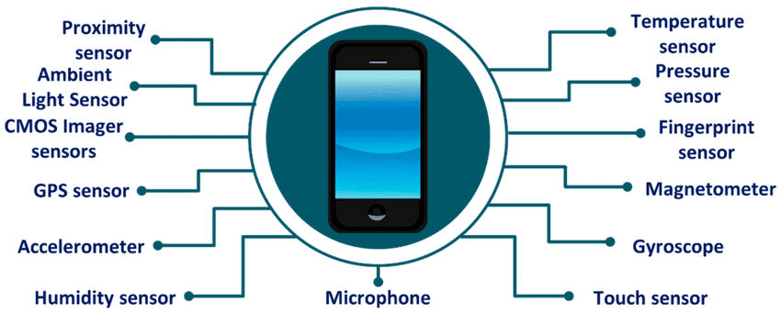
Sources of Big Data
Social Media:
Platforms like Facebook, Twitter, Instagram.
Examples: Posts, tweets, photos, videos, comments.
Sensors and IoT Devices:
Smart homes, wearables, industrial sensors.
Examples: Temperature readings, fitness data, machinery monitoring.
Business Applications:
Financial, Retail, Health, Government systems and application.
Examples: Banks Transactions, Purchase history, account activity.
Data Logs and Machine Data:
Generated by servers, applications, and network devices.
Examples: Web server logs, application logs, network traffic logs.
Public Data:
Government reports, weather data, research publications.
Examples: Census data, meteorological data, scientific datasets.

Slide 12
Importance and Applications of Big Data

Slide 13
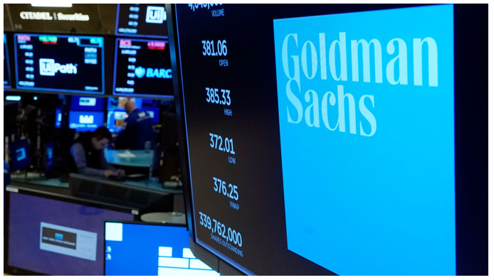
Real-Time Stock Market Analysis
Goldman Sachs uses big data to perform real-time stock market analysis, enabling high-frequency trading and informed investment decisions.
Data Volume: Goldman Sachs processes terabytes of data daily, including market transactions, historical stock prices, and economic indicators.
Data Velocity: The stock market generates data at an extremely high velocity, with thousands of trades executed every second that need to be analyzed instantly to capitalize on market opportunities.
Conventional Limitation: Traditional financial analysis systems cannot keep up with the high frequency and vast amount of data, leading to delays in trading decisions and missed opportunities.
Big Data Parallelism: Big data platforms utilize distributed computing and parallel processing to analyze real-time data streams from the stock market, enabling Goldman Sachs to execute trades within milliseconds and make timely investment decisions based on comprehensive and up-to-date information.

Slide 14
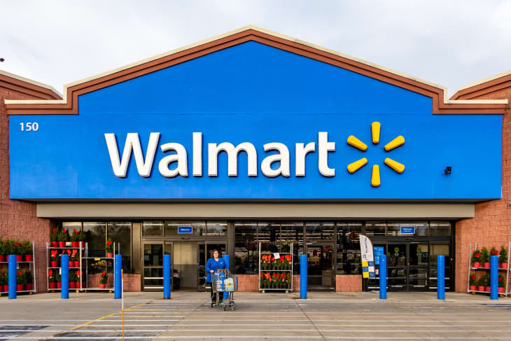
Customer Behavior Analysis in Retail
Walmart uses big data to analyze customer behavior, optimizing inventory management and personalized marketing.
Data Volume: Walmart processes over 2.5 petabytes of data every hour from transactions, customer interactions, and inventory records.
Data Velocity: With millions of transactions occurring daily across thousands of stores worldwide, Walmart generates data in real-time that needs to be processed instantly to make timely decisions.
Conventional Limitation: Traditional retail analytics systems cannot handle the massive volume and real-time processing requirements, leading to delayed insights and suboptimal inventory management.
Big Data Parallelism: Big data systems allow Walmart to process vast amounts of data in parallel across distributed computing resources, enabling real-time analytics to forecast demand, optimize stock levels, and personalize marketing efforts effectively.

Slide 15


Personalized Medicine and Genomic Analysis:
The Mayo Clinic uses big data for personalized medicine by analyzing genomic data to tailor treatments to individual patients.
Data Volume: The Mayo Clinic processes petabytes of genomic data, which includes sequencing information from millions of patients' DNA.
Data Variety: Genomic data is highly diverse, including information on gene sequences, protein interactions, and patient medical histories.
Conventional Limitation: Traditional computing methods struggle to handle the vast, complex, and varied datasets required for genomic analysis, often resulting in prolonged processing times and less precise treatment recommendations.
Big Data Parallelism: Big data platforms use parallel processing and advanced algorithms to analyze vast genomic datasets quickly and accurately, enabling the Mayo Clinic to develop personalized treatment plans based on an individual's genetic makeup, thereby improving treatment efficacy and patient outcomes.

Slide 16
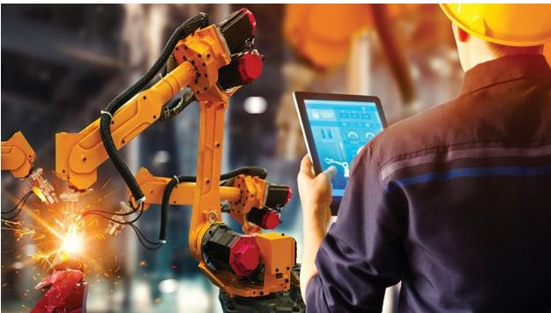
Predictive Maintenance in Manufacturing
General Electric (GE) uses big data for predictive maintenance to improve equipment reliability and reduce downtime in its manufacturing plants.
Data Volume: GE processes terabytes of data daily from sensors embedded in machinery, capturing information such as temperature, vibration, and pressure.
Data Velocity: The sensors generate data in real-time, with thousands of data points per second that need to be analyzed continuously to detect potential equipment failures.
Conventional Limitation: Traditional maintenance systems rely on scheduled inspections and reactive repairs, which can miss early signs of equipment degradation and lead to unplanned downtime.
Big Data Parallelism: Big data platforms enable GE to analyze real-time sensor data using machine learning algorithms and distributed computing. This allows for the early detection of anomalies and prediction of equipment failures before they occur, facilitating proactive maintenance and minimizing downtime.

Slide 17
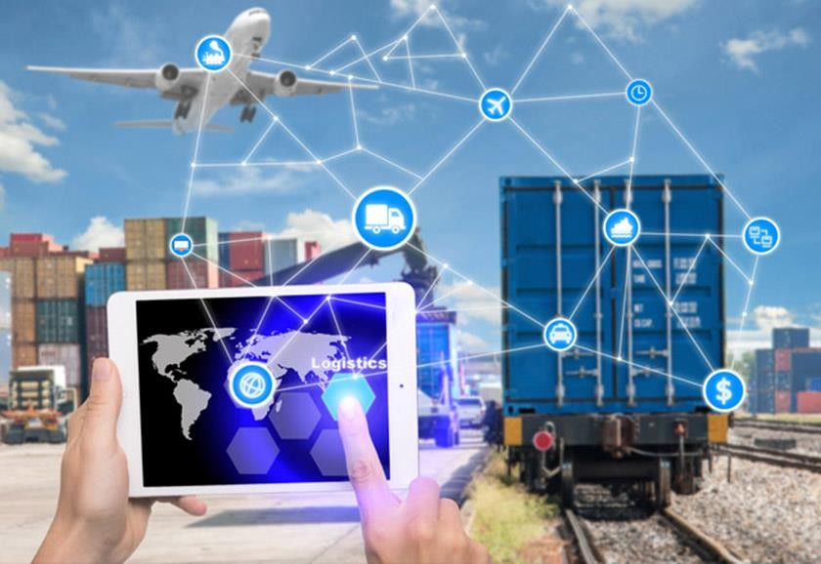
Fleet Management in Transportation
UPS uses big data for fleet management to optimize delivery routes, reduce fuel consumption, and improve delivery times. It can use data to predict demand, weather, traffic and improve efficiency and customer satisfaction.
Data Volume: UPS processes over 16 petabytes of data annually from GPS devices, vehicle sensors, customer orders, and traffic information.
Data Velocity: The fleet generates data in real-time, with continuous updates on vehicle locations, speed, engine performance, and traffic conditions that need to be analyzed instantly.
Conventional Limitation: Traditional fleet management systems cannot handle the massive volume of data and lack the real-time processing capabilities needed to optimize routes dynamically and respond to changing conditions on the fly.
Big Data Parallelism: Big data platforms allow UPS to analyze real-time data from thousands of vehicles simultaneously, using advanced algorithms to optimize delivery routes, predict maintenance needs, and adjust for traffic conditions in real-time. This leads to reduced fuel consumption, lower operational costs, and improved delivery times.

Slide 18
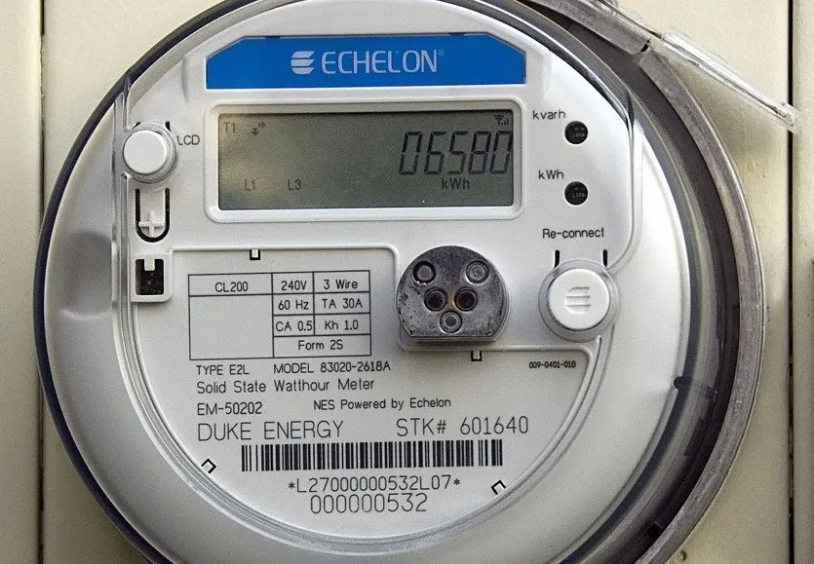
Smart Grid Management in the Energy Sector
Duke Energy uses big data for smart grid management to enhance energy distribution efficiency and reliability.
Data Volume: Duke Energy processes terabytes of data daily from smart meters, grid sensors, weather stations, and consumer usage patterns.
Data Velocity: Smart meters and grid sensors generate data in real-time, with updates every few seconds, providing continuous streams of information on energy consumption, grid status, and environmental conditions.
Conventional Limitation: Traditional energy management systems struggle to process and analyze the vast amounts of real-time data needed to optimize grid performance and respond to issues quickly, leading to inefficiencies and slower response times to outages or demand spikes.
Big Data Parallelism: Big data platforms enable Duke Energy to analyze real-time data from millions of smart meters and sensors simultaneously, using parallel processing and advanced analytics to optimize energy distribution, predict and prevent outages, and balance supply with demand dynamically. This results in a more efficient, reliable, and responsive energy grid.

Slide 19
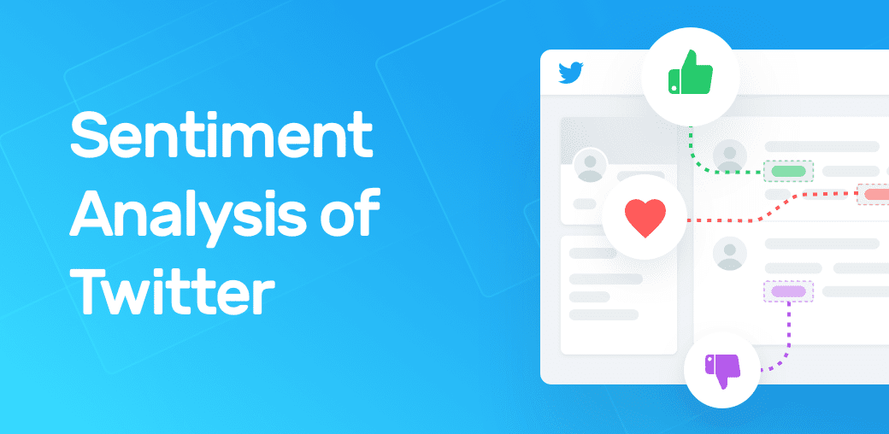
Sentiment Analysis and Trend Prediction in Social Media
Twitter uses big data to perform sentiment analysis and predict trends, helping businesses and advertisers understand public opinion and market trends.
Data Volume: Twitter processes over 500 million tweets daily, amounting to terabytes of data that include text, images, videos, and user interactions.
Data Velocity: The platform generates data at an extremely high velocity, with thousands of tweets being posted every second, requiring real-time analysis to capture trending topics and shifts in public sentiment.
Conventional Limitation: Traditional text analysis systems cannot keep up with the high speed and sheer volume of social media data, leading to delayed insights and missed opportunities to capitalize on emerging trends.
Big Data Parallelism: Big data platforms allow Twitter to analyze vast amounts of real-time data using distributed computing and natural language processing (NLP) algorithms. This enables the platform to provide instant insights into public sentiment, identify trending topics as they emerge, and deliver targeted content to users.

Slide 20
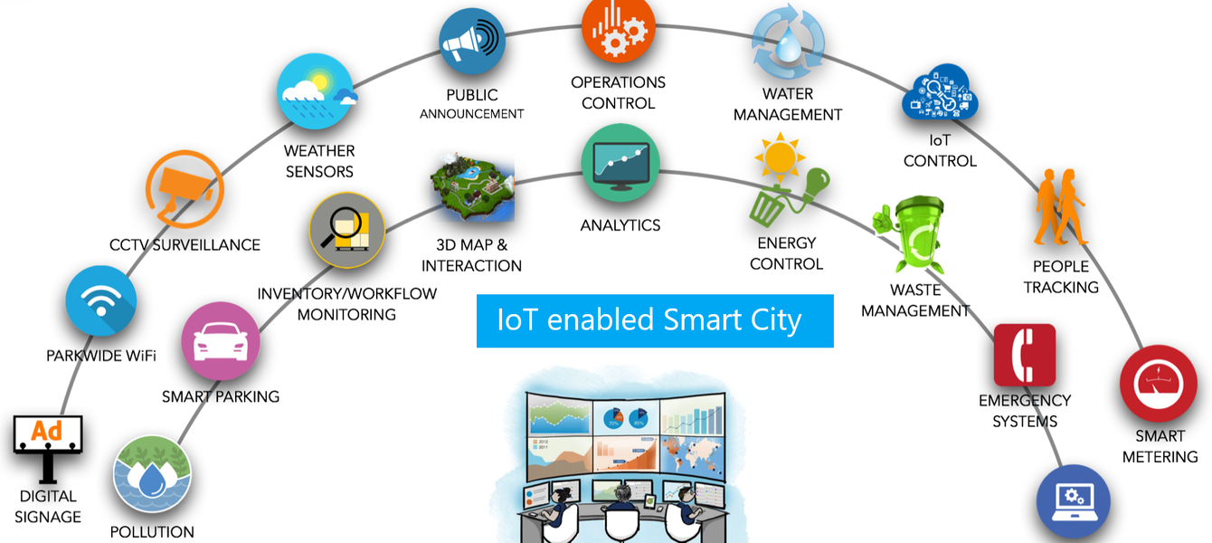
Smart City Infrastructure Management using IoT
Barcelona uses big data and IoT for smart city infrastructure management to improve urban living and resource efficiency.
Data Volume: Barcelona collects petabytes of data annually from thousands of IoT sensors deployed across the city, monitoring everything from traffic flow and air quality to energy usage and waste management.
Data Velocity: IoT sensors generate data continuously in real-time, providing constant updates on various parameters such as traffic congestion, pollution levels, and energy consumption.
Conventional Limitation: Traditional urban management systems cannot handle the vast amounts of high-velocity data from numerous sensors, leading to delayed responses and inefficient resource utilization.
Big Data Parallelism: Big data platforms enable Barcelona to process and analyze real-time data streams from IoT sensors using distributed computing and advanced analytics. This allows for dynamic traffic management, real-time monitoring of environmental conditions, efficient energy distribution, and timely waste collection, significantly enhancing the city's operational efficiency and quality of life for its residents.

Slide 21
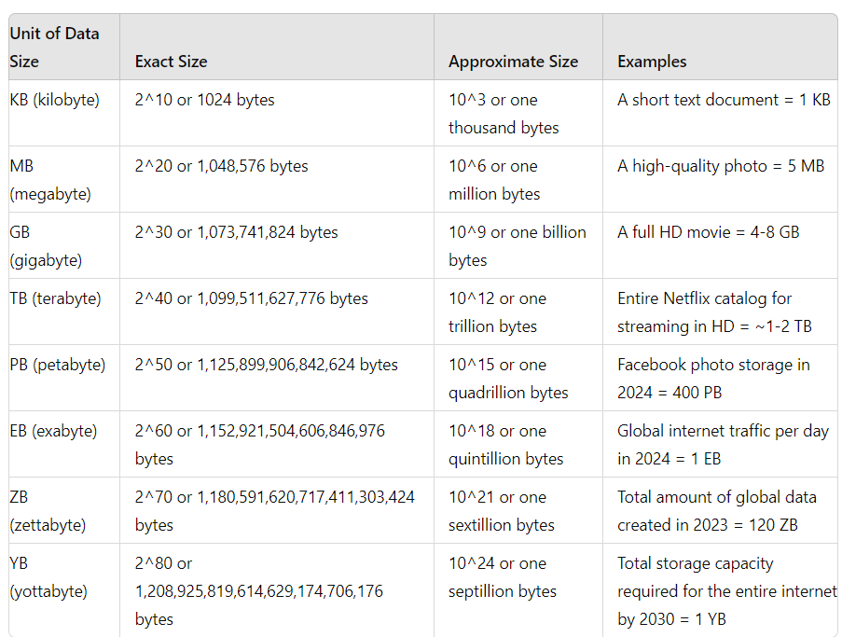
Data Sizes and Data Units

Slide 22
This table that maps hardware specifications (RAM & CPU) to data size limits and the best-suited technologies for processing
Hardware Specs | Data Size Range | Recommended Technology | Notes
Low-end Laptop (4GB RAM, Dual-Core CPU) | < 100MB | Excel, Pandas (small data) | Suitable for small datasets like CSVs, spreadsheets.
Mid-range Laptop/Desktop (8GB RAM, Quad-Core CPU) | 100MB – 1GB | Pandas, SQLite, Polars | Pandas works but may slow down, Polars is more efficient.
High-end Desktop (16GB RAM, 6-8 Core CPU) | 1GB – 10GB | Pandas (optimized), Dask, PostgreSQL | Dask allows parallel processing; SQL databases handle structured data well.
Workstation (32GB RAM, 8-12 Core CPU) | 10GB – 100GB | Dask, Polars, PySpark (local mode), PostgreSQL | Dask and Polars can handle larger-than-memory datasets efficiently.
High-performance Workstation (64GB+ RAM, 12+ Core CPU) | 100GB – 500GB | PySpark (local cluster), DuckDB, BigQuery (cloud SQL) | Need distributed computing for efficiency.
Small Hadoop Cluster (3+ Nodes, 128GB+ RAM) | 500GB – 1TB | Apache Spark, Hadoop (MapReduce, Hive), Databricks | For large-scale batch processing and analytics.
Enterprise-Scale Cluster (10+ Nodes, 1TB+ RAM) | 1TB+ | Apache Spark, Hadoop, Google BigQuery, Azure Databricks | Cloud-based or distributed computing required for scalability.

